Slide 1
Terrorism activities analysis from 2012 to 2015
Fe550 individual final project
Disha an

Slide 2
Table of content
INTRODUCTION
DATA SOURCE
DATA SOLUTION ARCHITECTURE
RESEARCH QUESTIONS & ANSWERS
TOOLS CHOSEN
OPPORTUNITITES FOR FUTURE WORK

Slide 3
INTRODUCTION
According to Wikipedia, terrorism is the use of intentionally indiscriminate violence to create terror or fear to achieve a political, religious, or ideological propose. Recent years, several countries have suffered a lot in these terrorism attacks. By analyzing the global terrorism database, we can find the trend of the terrorism activities, the active terrorism areas and other information behind this global terrorism database. By using the analyzed results, we may can implement these results for avoiding terrorism areas and preventing potential risk of fatalities or injuries in the future.
The objective of my individual project is to analyze different countries historical terrorism activities and corresponding detailed information of terrorist behavior in order to get a general idea of the terrorism activities from 2012 to 2015.

Slide 4
Data source
Original Dataset
Time Period: 1970-2015
Total Variables: 137
Cleaned Dataset
Time Period: 2012-2015
Total Variables: 42
Total Entries: 156772
Dataset Name: Global Terrorism Database
Total Entries: 52134
Dataset Name: data2012_2015.csv
The dataset comes from Kaggle: https://www.kaggle.com/START-UMD/gtd

Slide 5
Data solution architecture
Rattle is for data mining
R is for analyzing and data cleaning
Clean data
Tableau is for data visualization
Data Cleaning Standardization:
Omit the NA values more than 50% of the variables
Delete the variables that measure the same feature. Example: attacktype1 and attacktype1_txt, delete attacktype1, and keep attacktype1_txt. Since both of two represent attack type, the former is value version.

Slide 6
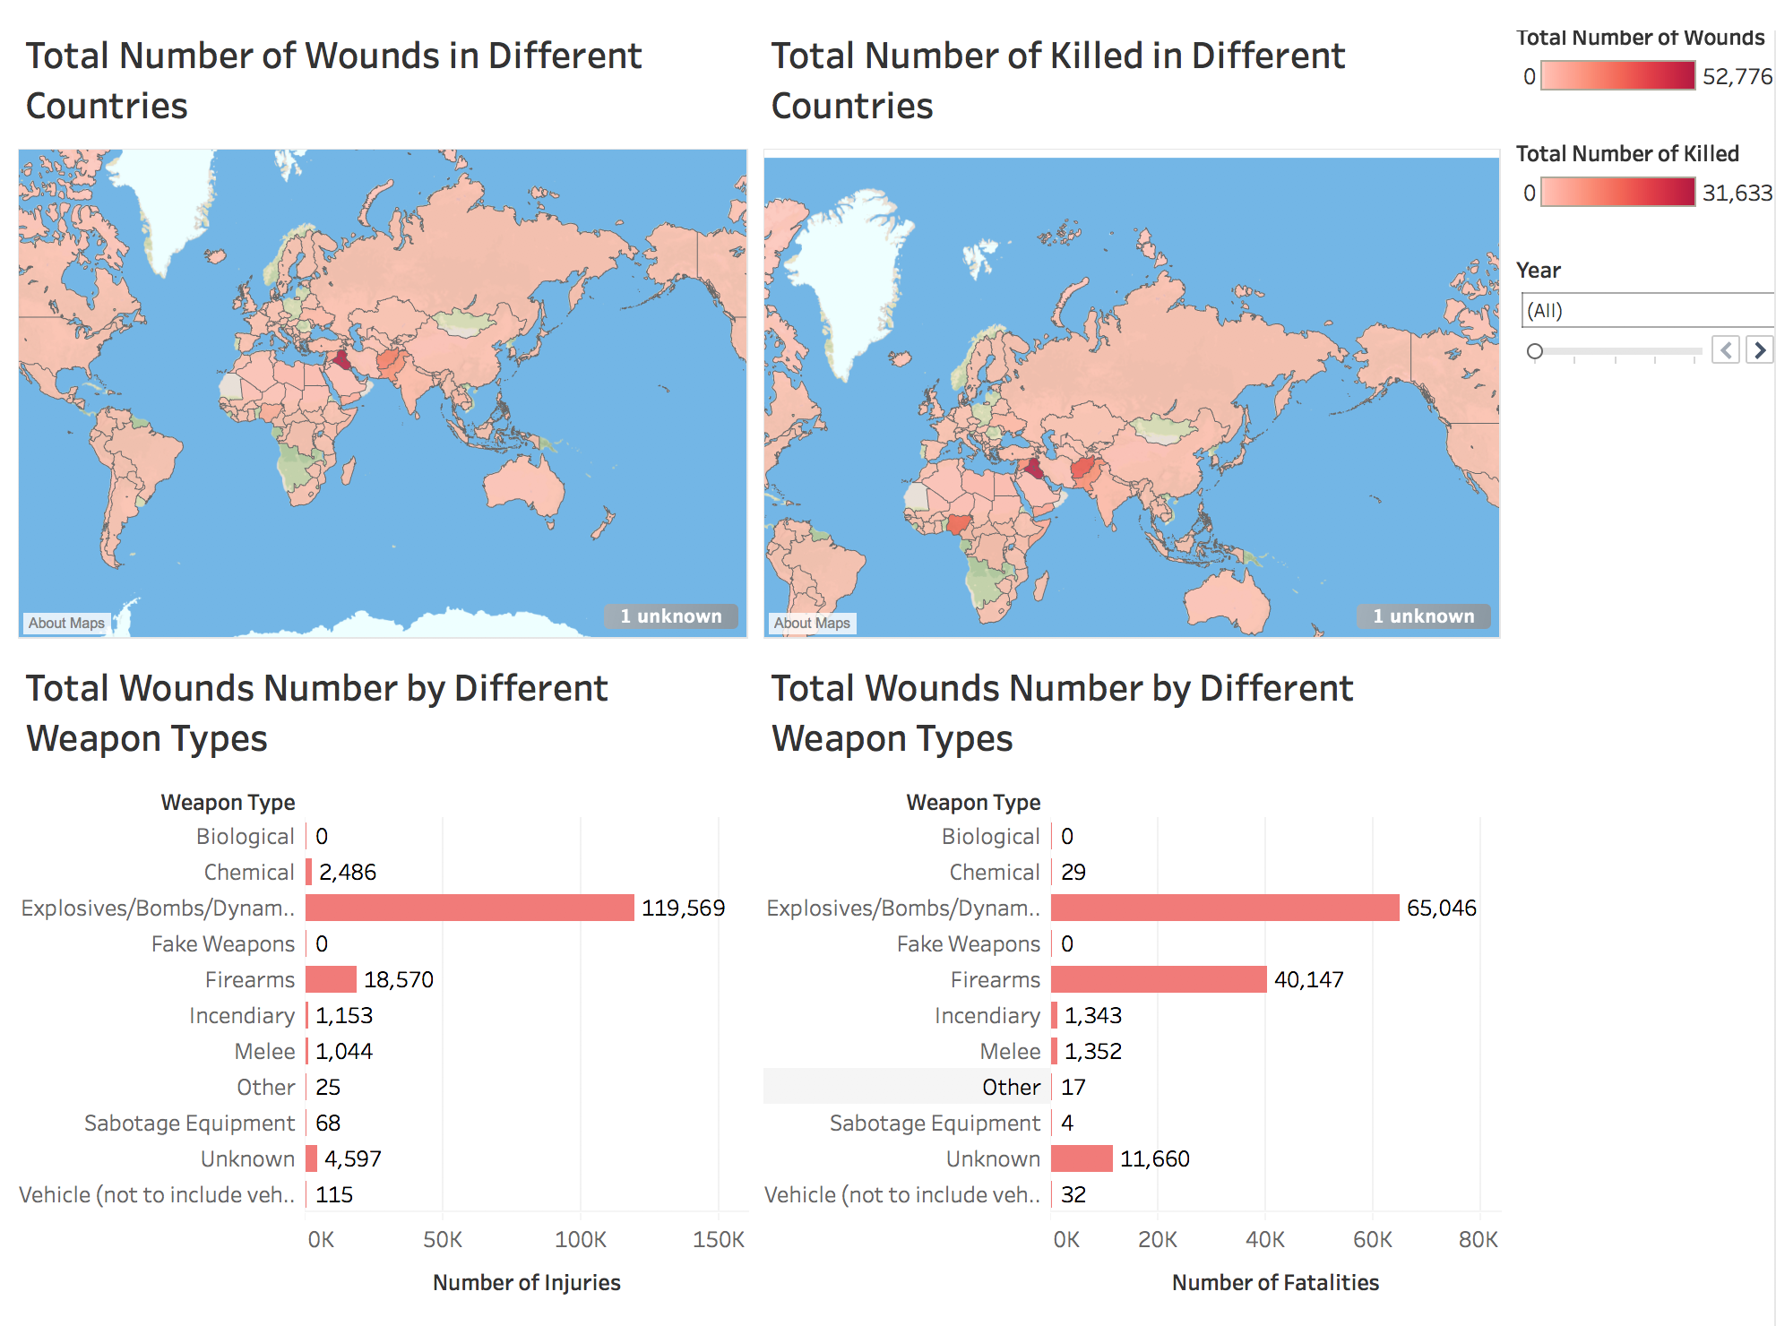
Research questions & answers
The number of fatalities and injuries worldwide distribution and weapons distribution.
From the right plots, we can see that most countries in the world have suffered terrorist attack. The largest number of fatalities and injuries are in Iraq.
Most people were died or injured because of explosives.

Slide 7
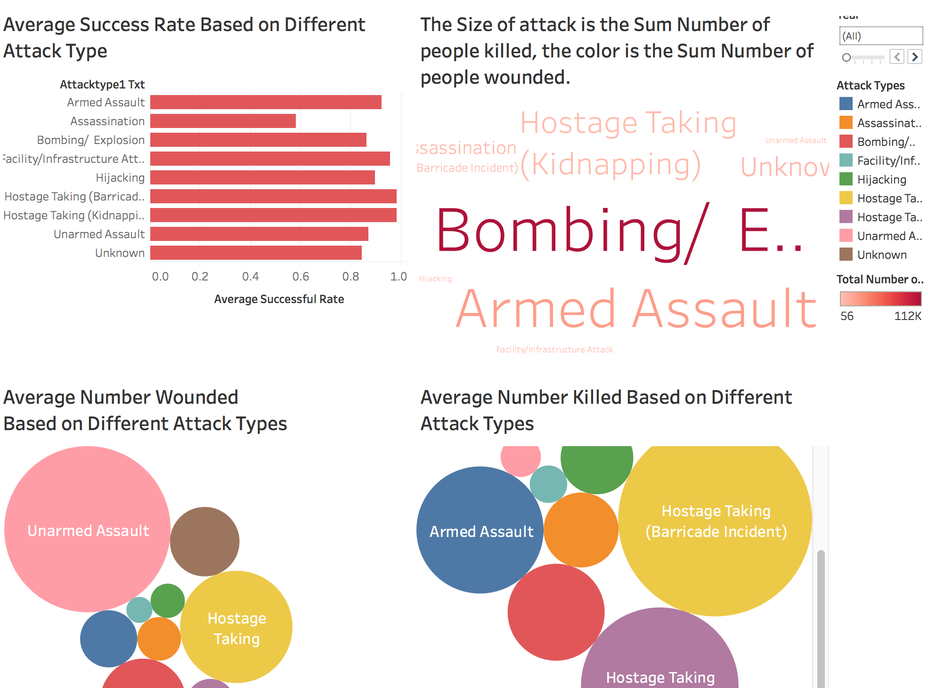
Research questions & answers
The successful rate of each attack type. The consequences caused by different attack types.
We can see that most of the attack types have good successful rates, which indicate that the mission for preventing the terrorism attack is so difficult.
Most successful attack type are dealing with hostage.
Hostage also is related to fatalities and injuries.
Unarmed assault causes a lot injuries

Slide 8
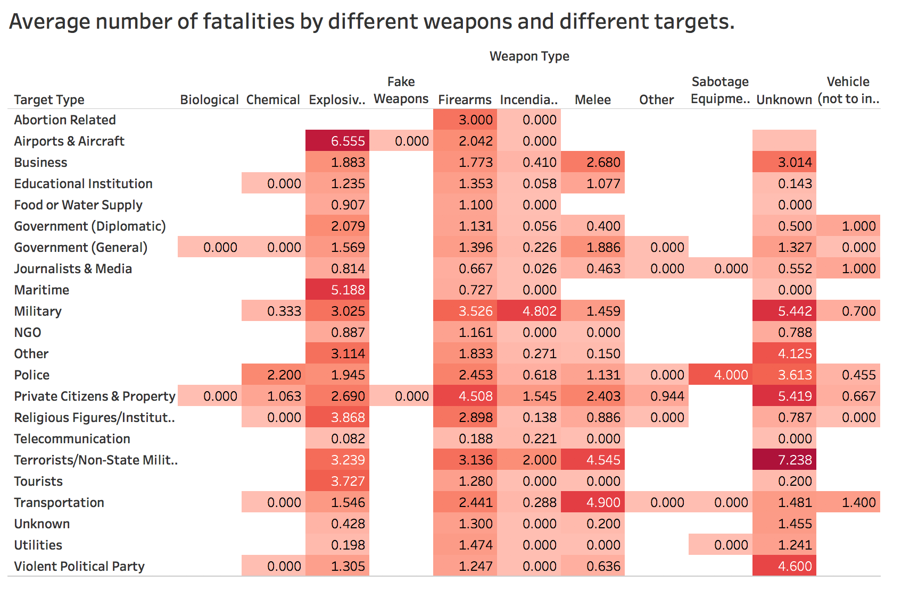
Research questions & answers
What kind of weapon and target cause the most average number of fatalities?
Except Unknown column, we can see that the explosive weapons in airports can be the biggest average number of fatalities.
Incendiary in military and melee dealing with tourists also caused lots of fatalities. In common sense, incendiary and melee can be prevented more easily than other type of weapons.

Slide 9
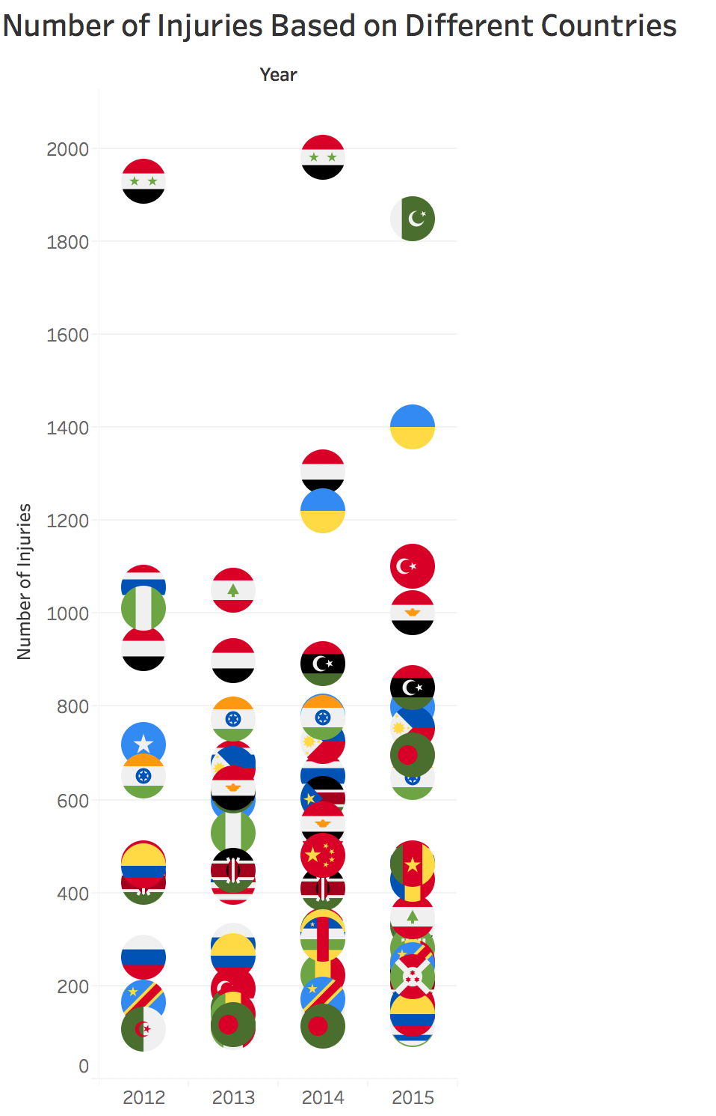
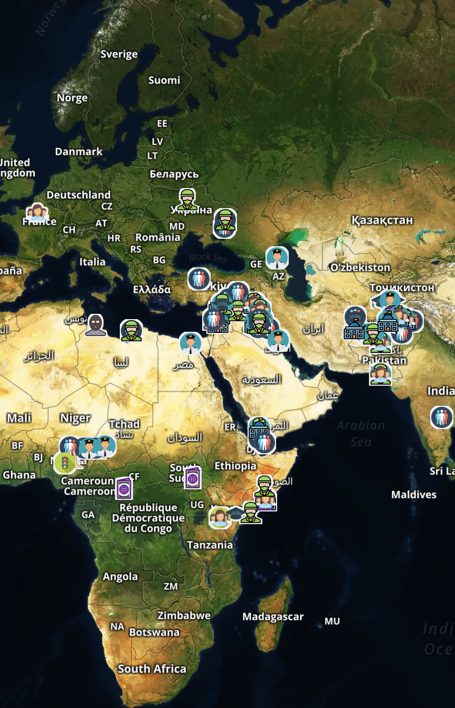
TOOLS CHOSEN
Add flags and small indication icons for illustration.
Use the “shape” feature and Flat Icon to make a better visualization in tableau.
Use Mapbox to edit the maps to have a more beautiful map plots.

Slide 10
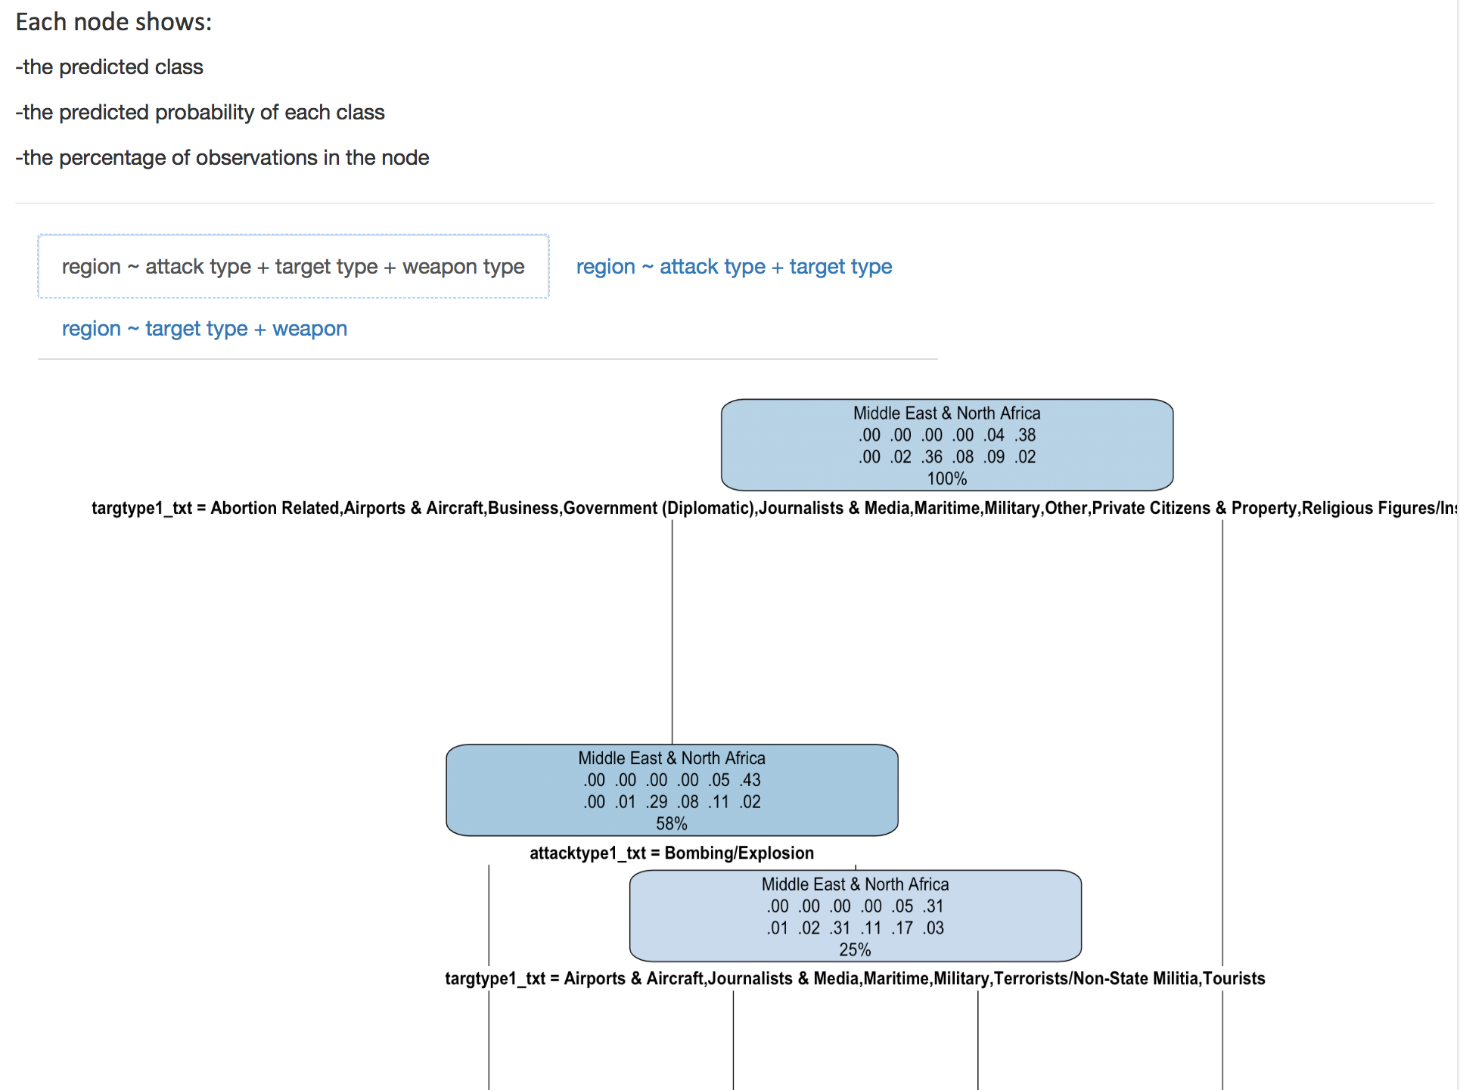
Tools chosen
Embed the Shiny app to show the tree analysis.
Method: publish the Shiny app and then add the Web Page object in the dashboard in Tableau.
The formulas included for the users to refer:
Region ~ attack type + target type + weapon type
Region ~ attack type + target type
Region ~ target type + weapon
If this part is not shown correctly in Story in Tableau, please open the story again. It because this Shiny app can only stay active for several minutes.

Slide 11
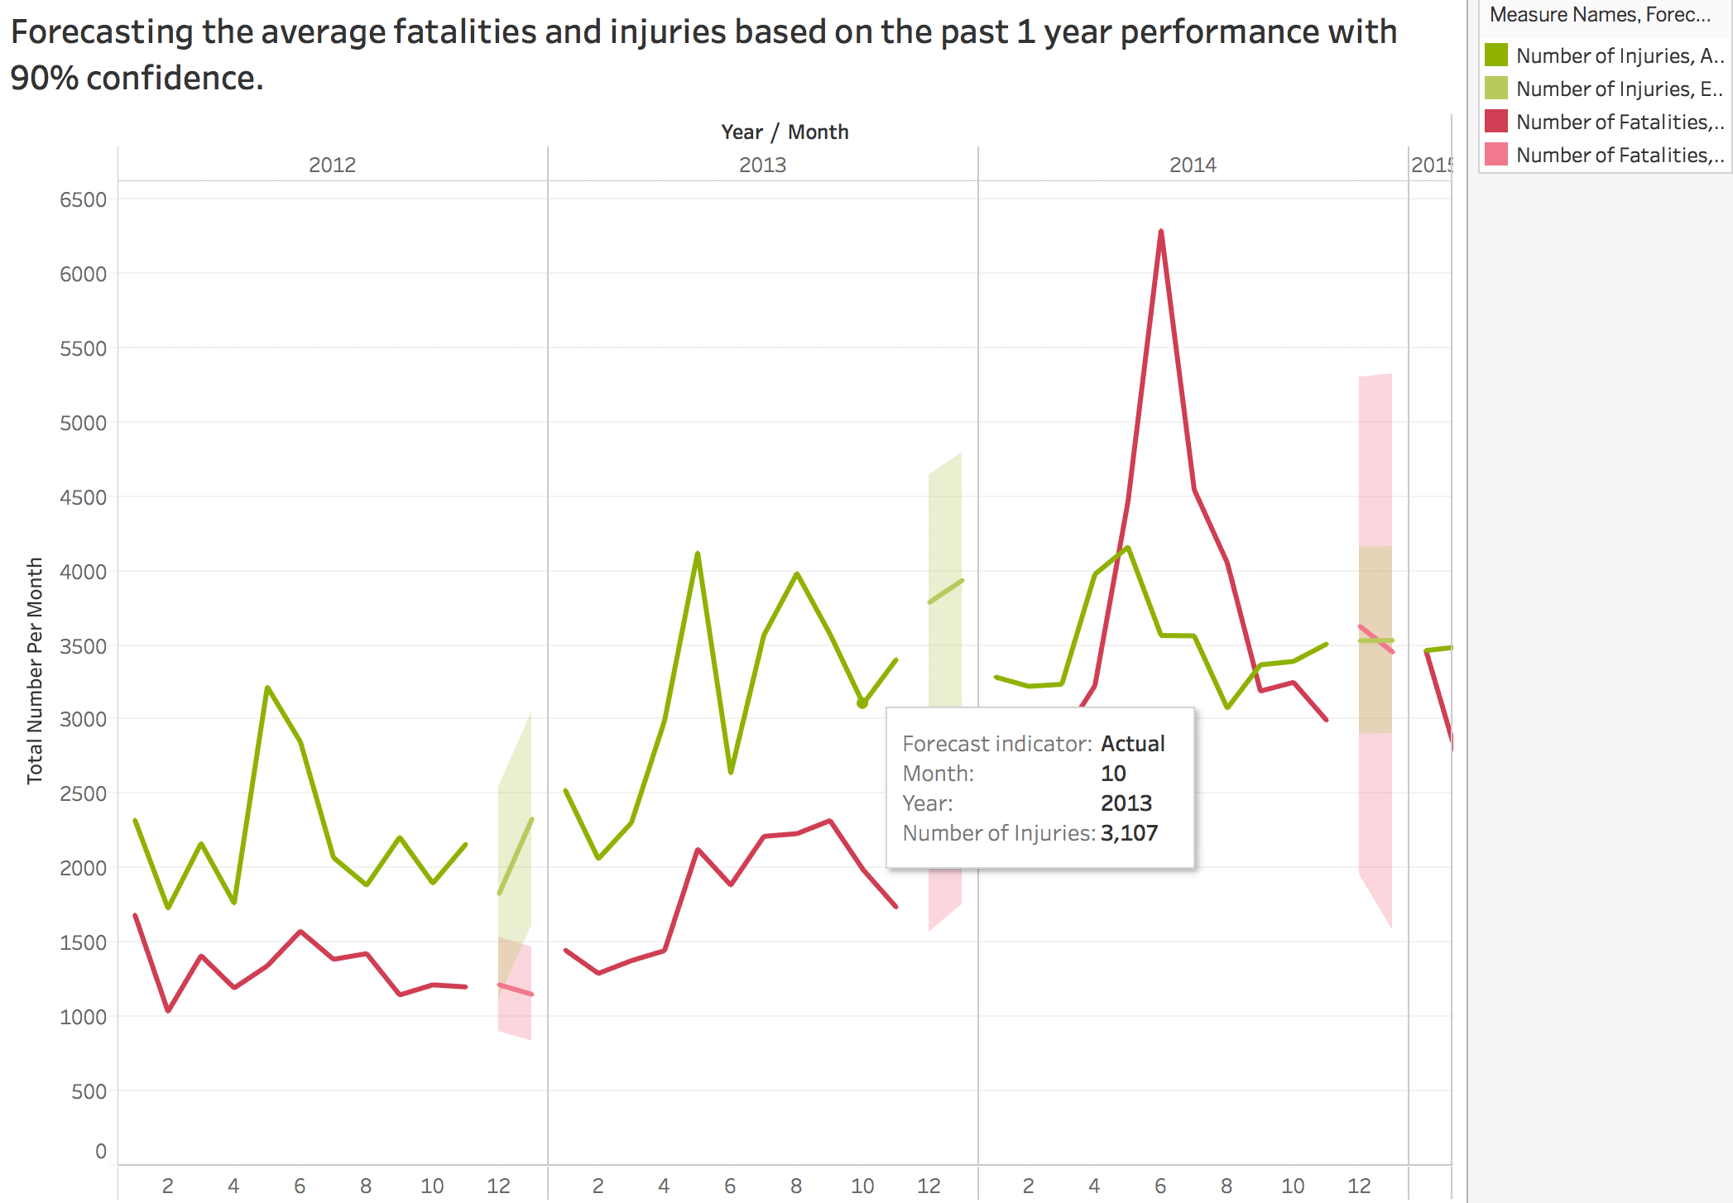
Tools chosen
Using forecasting tool in Tableau to forecast the number of fatalities and injuries.
We can see that from the right plot, sometimes the injuries and fatalities are not consistent with the trend we forecasted, but the actual trend is still in the area of confidence.

Slide 12
OPPORTUNITITES FOR FUTURE WORK
The possible future work is listed as follows:
The reason why I didn’t analyze the data before 2012 is that the standard for distinguish behavior of terrorism is different before 2012 and that after 2012. So if it’s possible, analyzing the previous data and making some same valuation of terrorism behavior will be so meaningful for analyzing terrorists’ behavior.
More elements can be taken into consideration for the projection of terrorism. For example, the female education rate, the health insurance coverage, GDP of each country, the corresponding local laws, human right evaluation, political ideology, and so on.
What the role social media plays in the way for expansion of terrorism groups. For example, the ISIS hired young candidate by sending the advertisement on Twitter.

Slide 13
Thank you

